Slide 1
Recycling coffee sacks

Slide 2
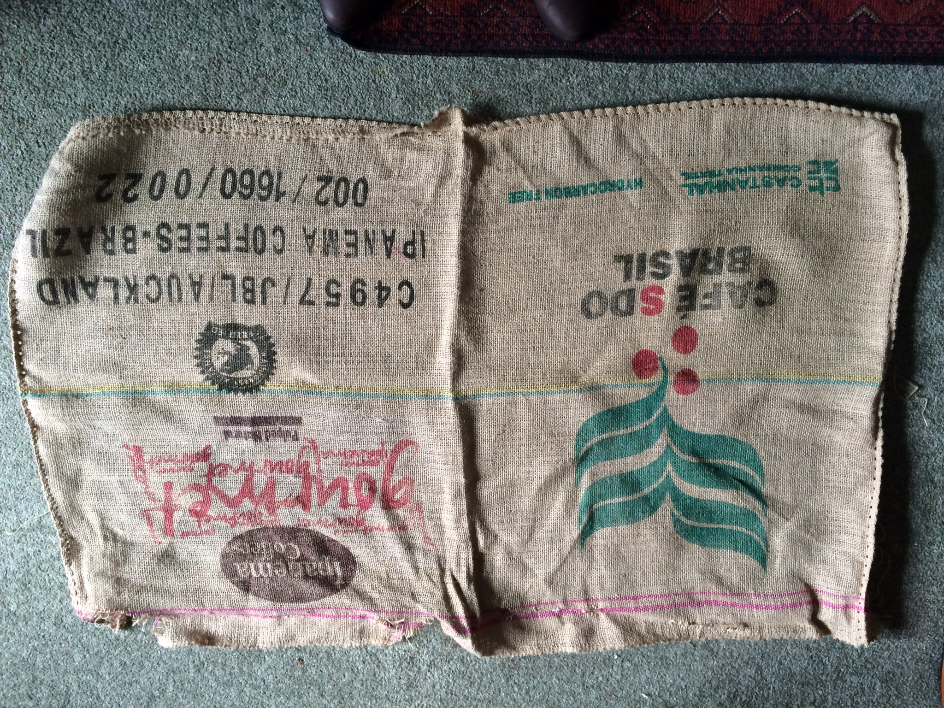
Unpick the bag

Slide 3
Save all of the parts to use later

Slide 4
Iron the sack flat

Slide 5
How many bags can I get ? What is the best way to cut them?

Slide 6
Pull a thread to get a straight edge

Slide 7
Keep all of the threads to use later

Slide 8
Make a pattern

Slide 9
Pin the pattern on the sack

Slide 10
Cut off the frayed edge

Slide 11
Cut out the bag along the top

Slide 12
Pull a thread along the side

Slide 13
Cut along the pulled thread

Slide 14
Take off the pattern

Slide 15
Save all of the scraps to use later

Slide 16
Find some recycled card

Slide 17
Draw your design on the cardboard

Slide 18
Cut out the middle start in the centre

Slide 19
Rub the cardboard with some oil to stop the paint seeping into the cardboard

Slide 20
Mix some white paint with a colour

Slide 21
Place the stencil on the bag and using very little paint dab it on

Slide 22
Paint the peg

Slide 23
Fray the top of the bag

Slide 24
Sew the sides together with back stitch

Slide 25
Pull 2 threads out below the frayed edge

Slide 26
Plait some threads together and thread this through the gap to make a tie

Slide 27
Paint on the inside of the stencil and make patterns on paper.

Slide 28
You can stitch on your bag using the coloured threads from the sack

Slide 29
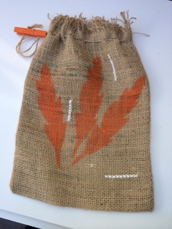
The finished bag

